Slide 1
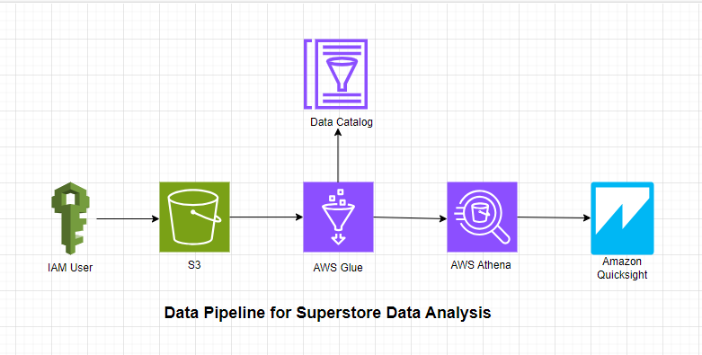
SUPERSTORE DATA PIPELINE IN AWS

Slide 2
Overview
This project implements a robust data pipeline for managing and analyzing monthly sales data from the Superstore dataset. The pipeline is designed to be incremental, allowing for efficient updates and additions to the dataset.
Key Components
Data Extraction and Transformation: Utilized a Python script for extracting monthly sales data, orchestrating the generation of new CSVs.
Storage and Partitioning: Organized CSVs into distinct S3 folders, implementing a partitioning strategy for efficient data management.
Cataloging with AWS Glue: Implemented an AWS Glue crawler, automating the cataloging process and seamlessly updating the Data Catalog table to reflect new partitions.
Querying with Amazon Athena: Executed direct querying of specific, updated, or added data from CSVs on S3 using Amazon Athena.
Visualization with Amazon QuickSight: Integrated with Amazon QuickSight, facilitating the creation of datasets, visualizations, and dashboards for in-depth data analysis.

Slide 3
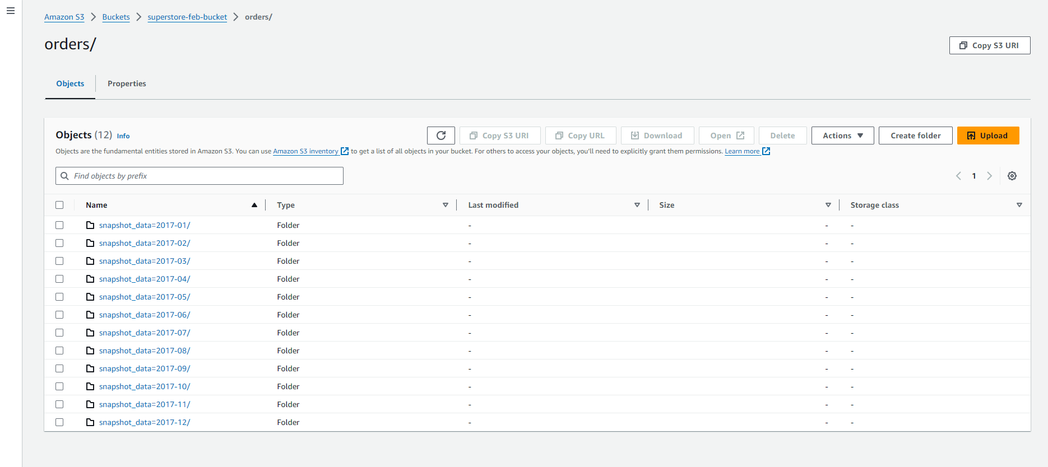
Incremental load of Monthly Sales data in S3

Slide 4
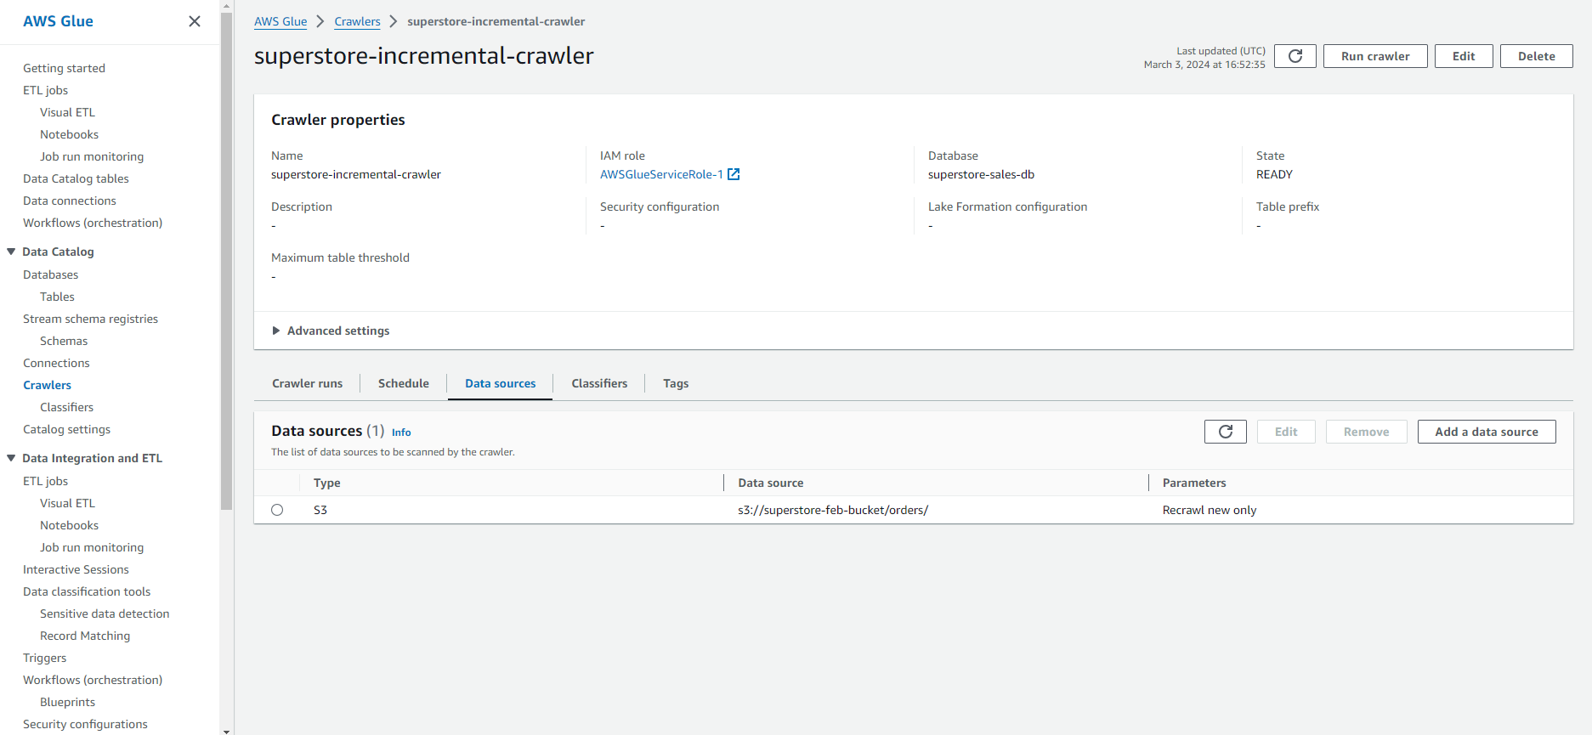
AWS Glue Crawler to create Data Catalog from S3 bucket – orders folder

Slide 5
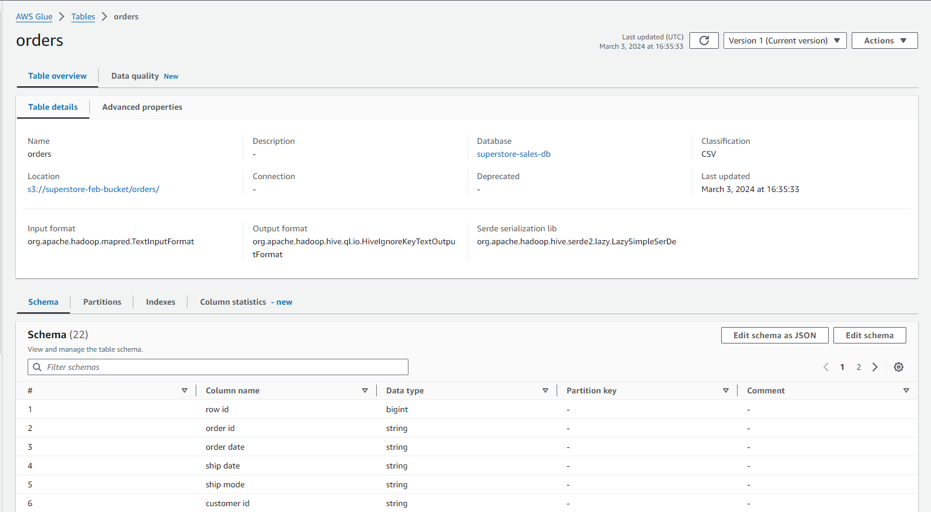
AWS Glue Data Catalog Table

Slide 6
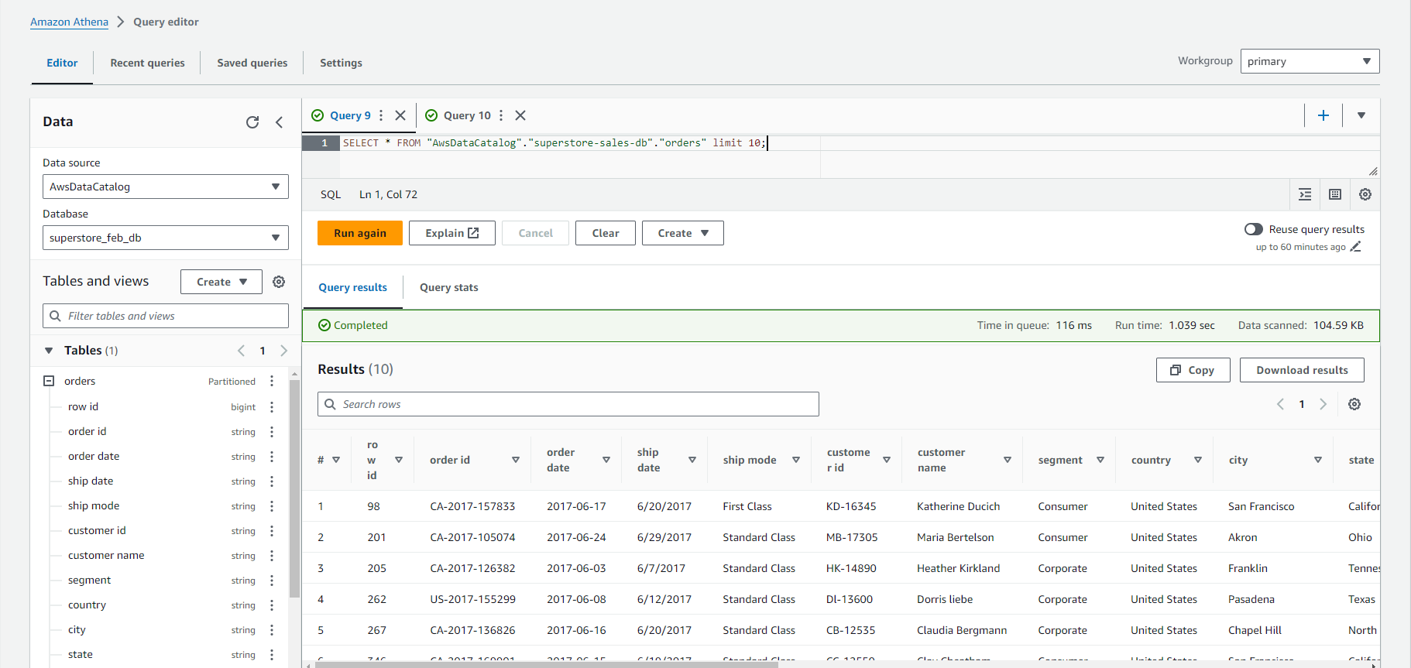
Querying Data in Athena

Slide 7
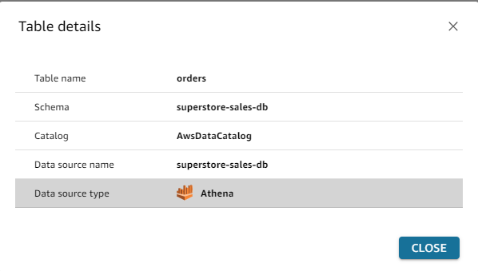
Creating Dataset in Amazon QuickSight

Slide 8
Data Visualization and Analysis in QuickSight

